Slide 1
Rotary International District 6560
Dale Basham,
District Governor 2018-2019

Slide 2
Rotary International The largest network of service clubs in the world
There are 529 Districts in more than 160 countries throughout the world.
District 6560 is in Zone 30, Indiana, Ohio, Kentucky, Mississippi, Alabama and parts of Tennessee.
District 6560, Central Indiana, has 44 clubs and about 2,000 members.

Slide 3
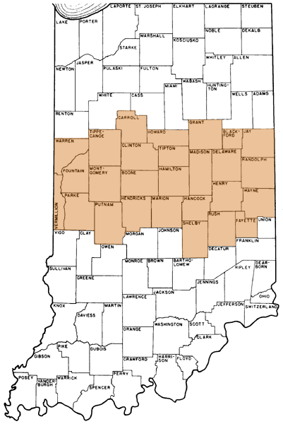
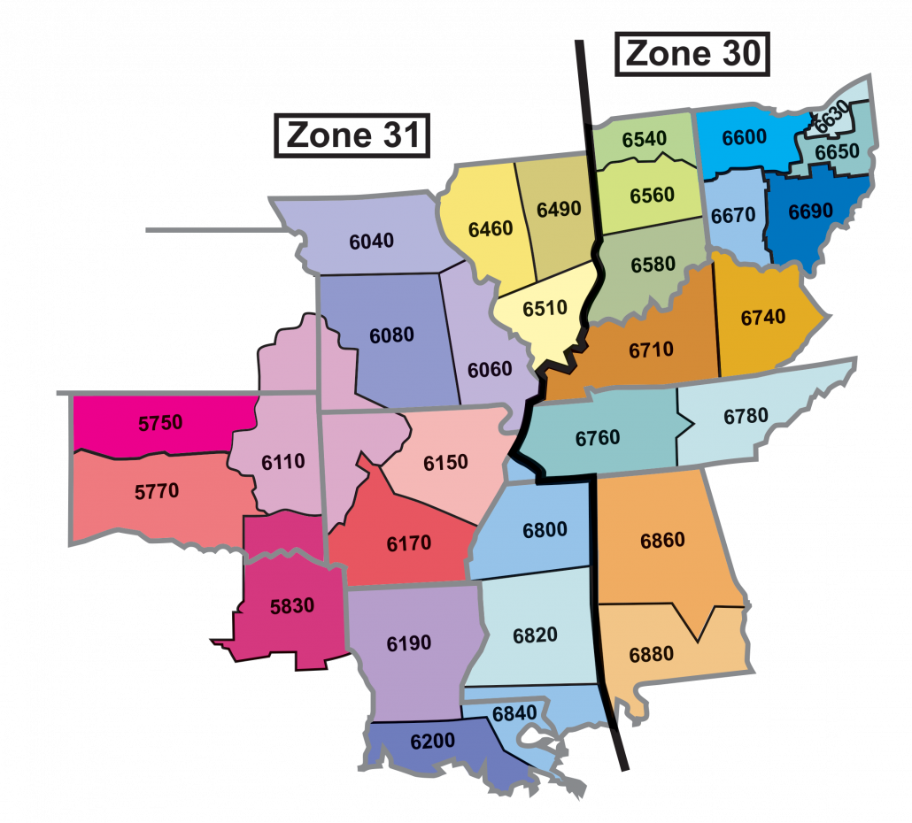
Heart of America 30 & 31
District 6560

Slide 4
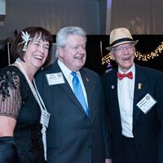

Rotary International & District 6560
Rotary International is governed by a president and a board of directors elected from all over the world.
Each District elects a District Governor annually.
Each club is, however, autonomous.
President Mark Maloney
Alabama
2019-2020
Governor Charles Shumate
Anderson
2019-2020

Slide 5
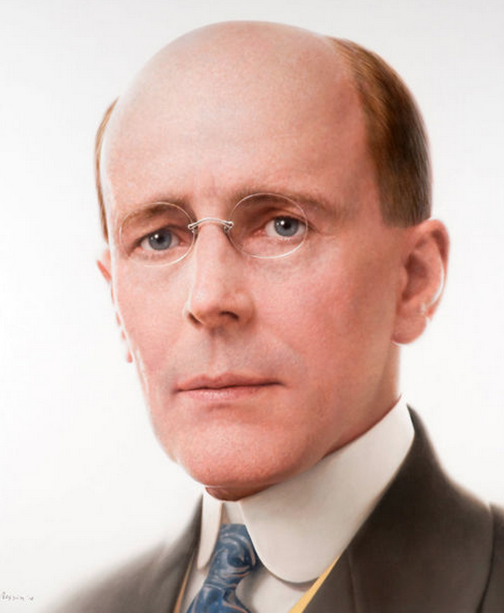
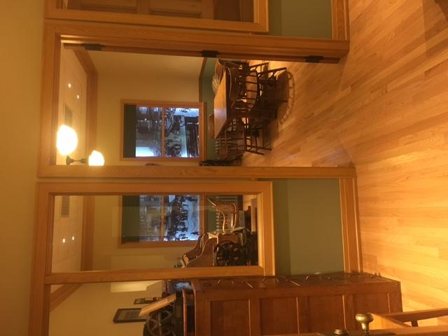
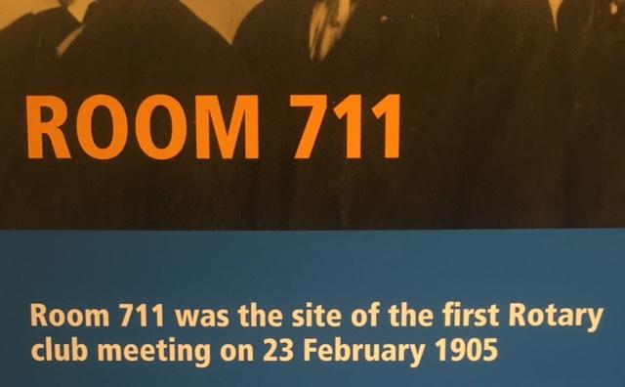
Paul P. Harris
On 23 February 1905, the original club, with four members, met in rotation at the offices of the members - thus the name Rotary.
There are more than 35,000 clubs with over
1.2 million members worldwide.

Slide 6
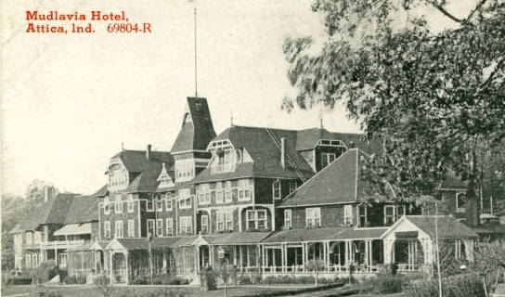
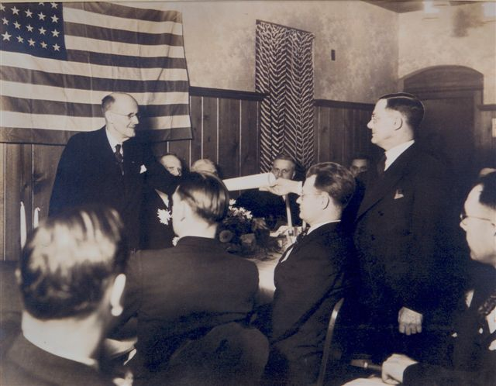
Attica-Williamsport Chartered by Paul Harris
12 January 1937
Notes:
Rotary Club of Muncie. We were formed in 1917 – the 327th club in the growing family of Rotary.

Slide 7
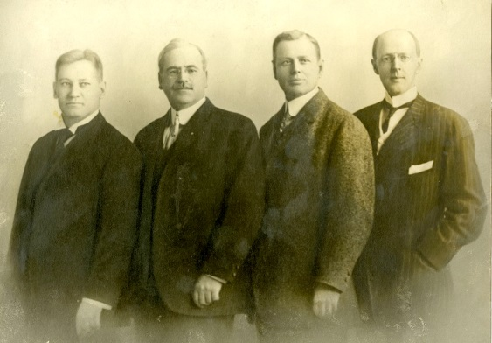
The first Rotarians were Gustavus Loehr, Silverster Shiele, Hiram Shorey, & Paul Harris.

Slide 8
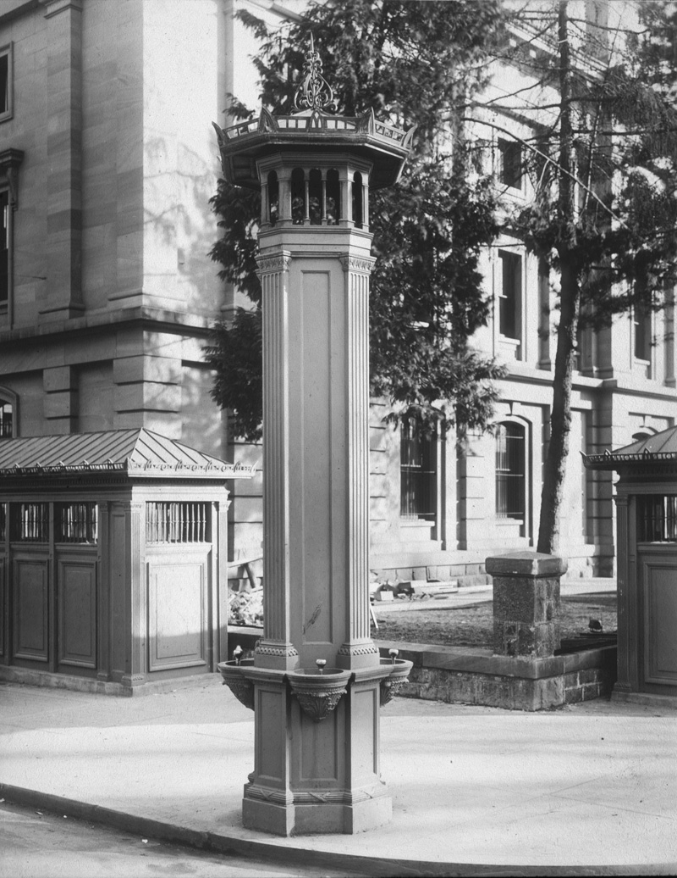
Service Above
Self

Slide 9
The Object of Rotary is to encourage and foster the ideal of service as a basis of worthy enterprise and, in particular, to encourage and foster:
The development of acquaintance as an opportunity for service.
High ethical standards in business and professions; the recognition of the worthiness of all useful occupations; and the dignifying by each Rotarian of his or her occupation as an opportunity to serve society.
The application of the ideal of service by every Rotarian to his or her personal business and community life
The advancement of international understanding, good will, and peace through a world of fellowship of business and professional people united in the ideal of service.

Slide 10
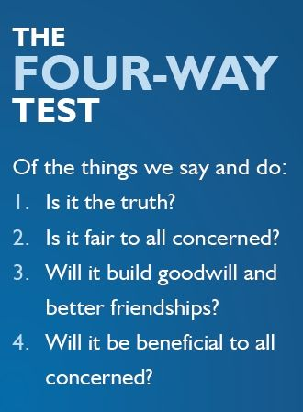

Slide 11
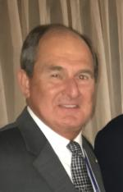
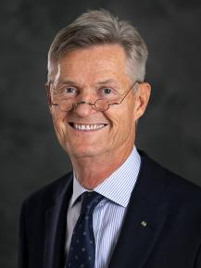

Joe Collings
District Governor Elect
Rockville
Holger Knack President Elect
Germany

Slide 12
Club Service
  Those things that a Rotarian does to help successfully run the local club.
Community Service
  Encourages Rotarians to serve others through their vocations and to participate in projects and activities to improve life in their community.
International Service
  Encourages and fosters the advancement of understanding and good will among people of the world.

Slide 13


Slide 14
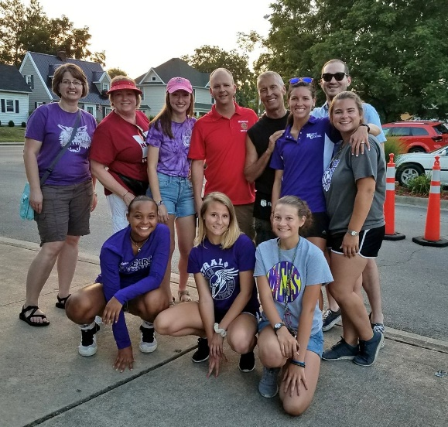
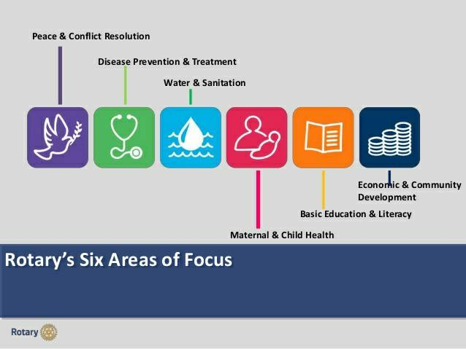
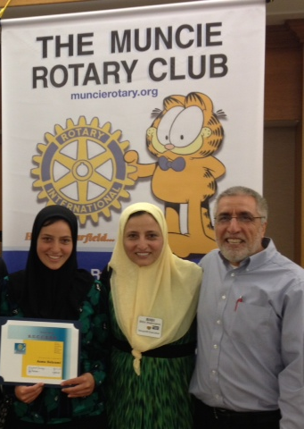
Basic Education & Literacy

Slide 15
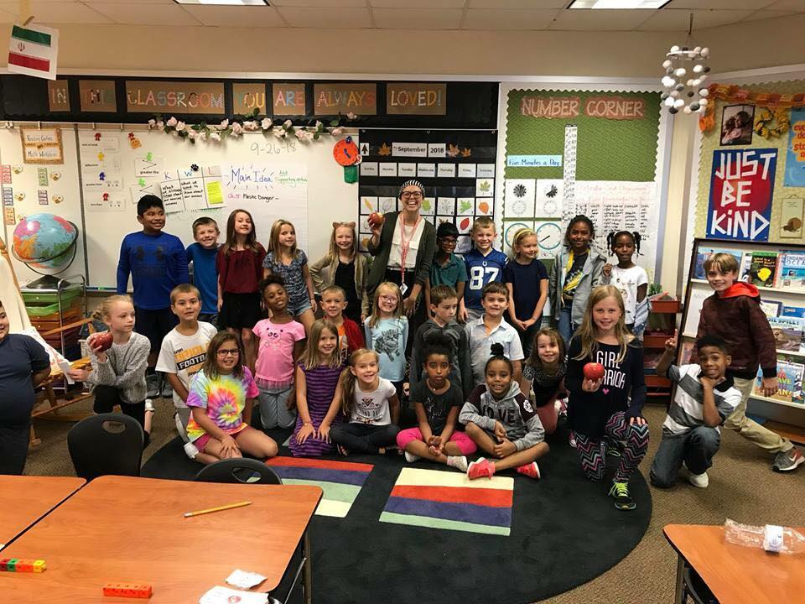
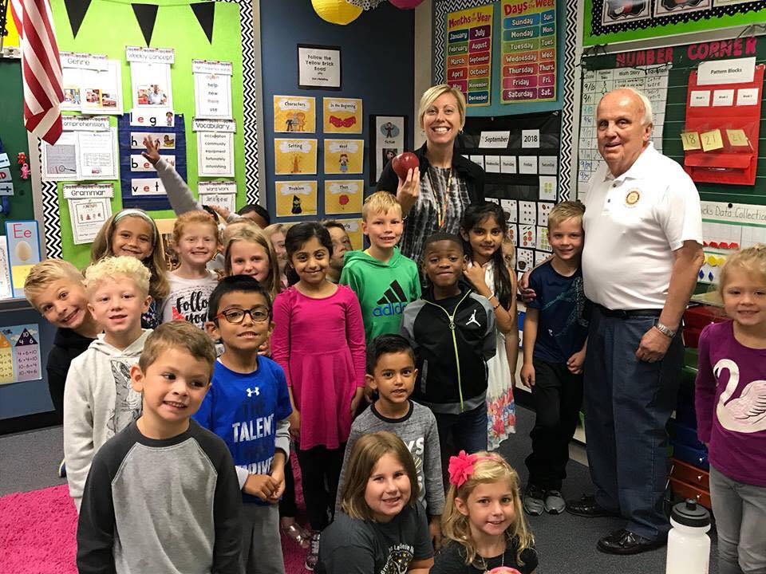
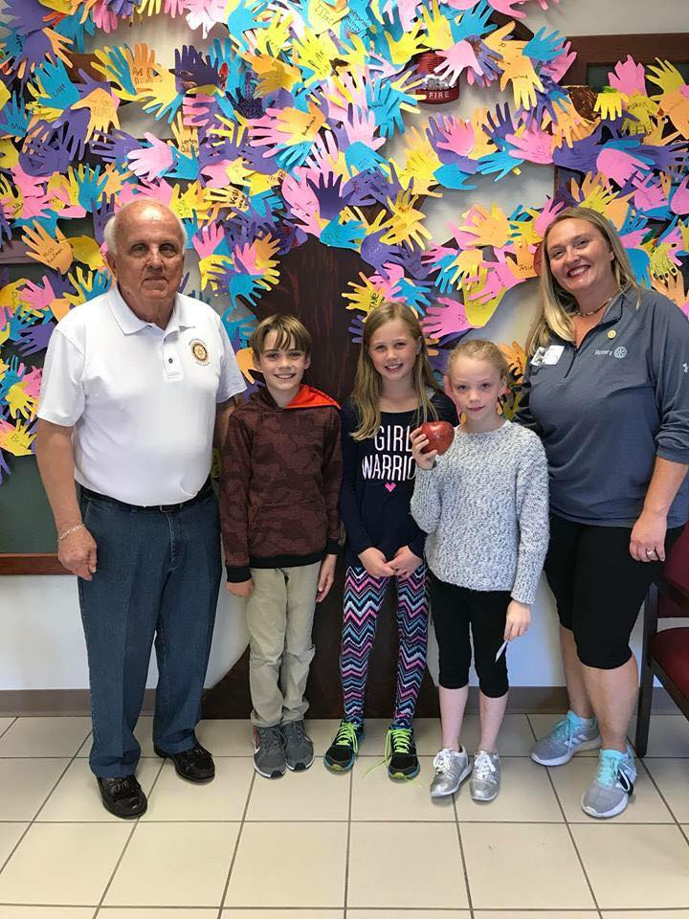
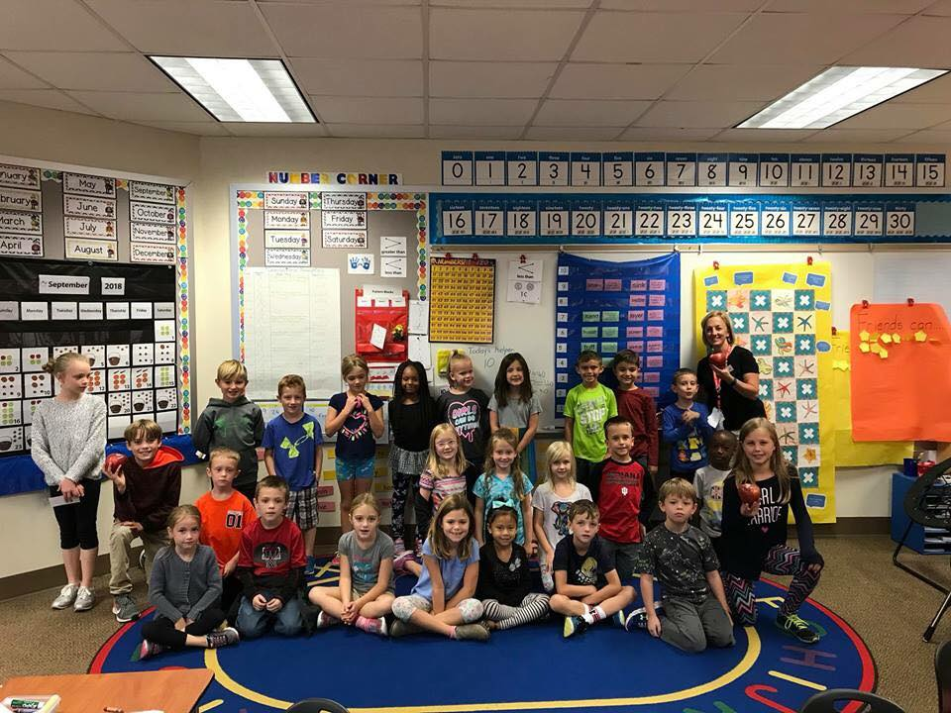
Avon Apples of Appreciation

Slide 16
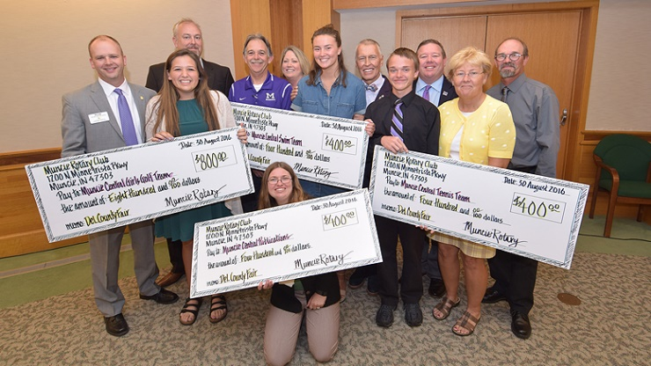

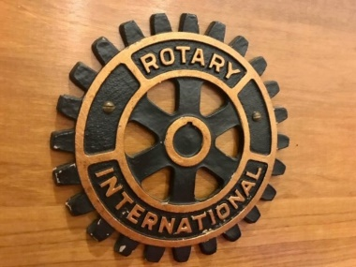

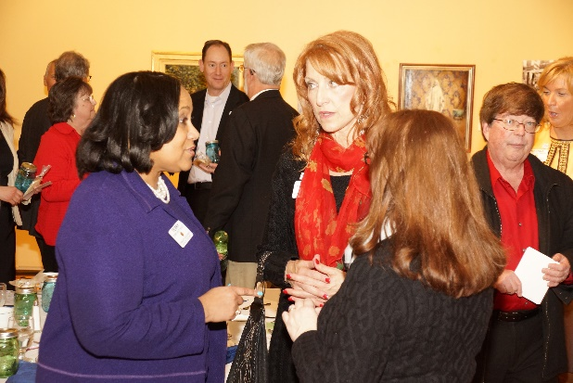
Service Above Self

Slide 17


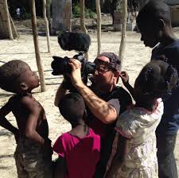
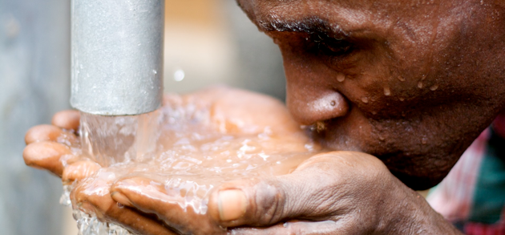
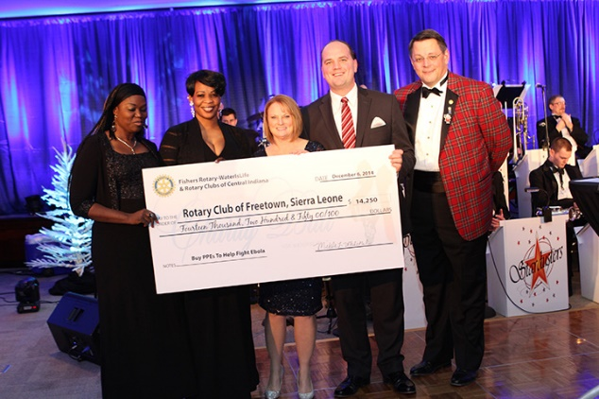
Water Is Life

Slide 18
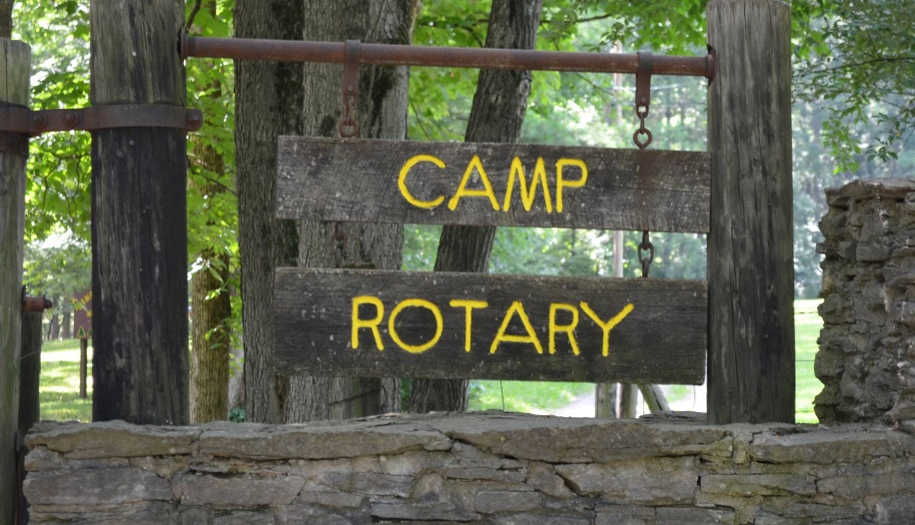

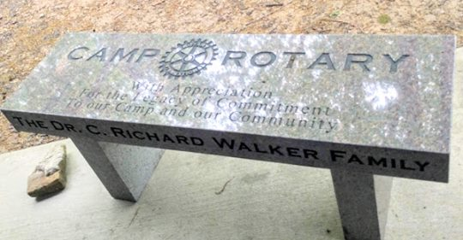
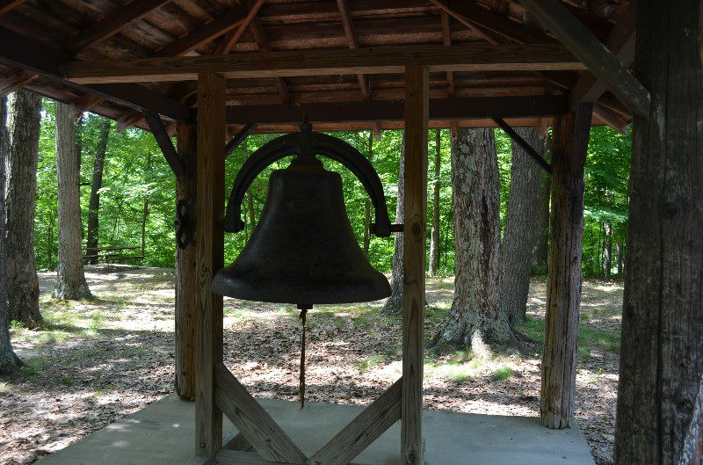
Camp Rotary  Crawfordsville Rotary

Slide 19
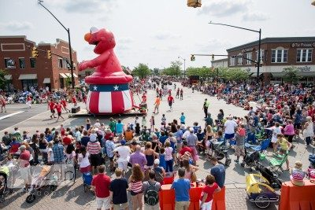

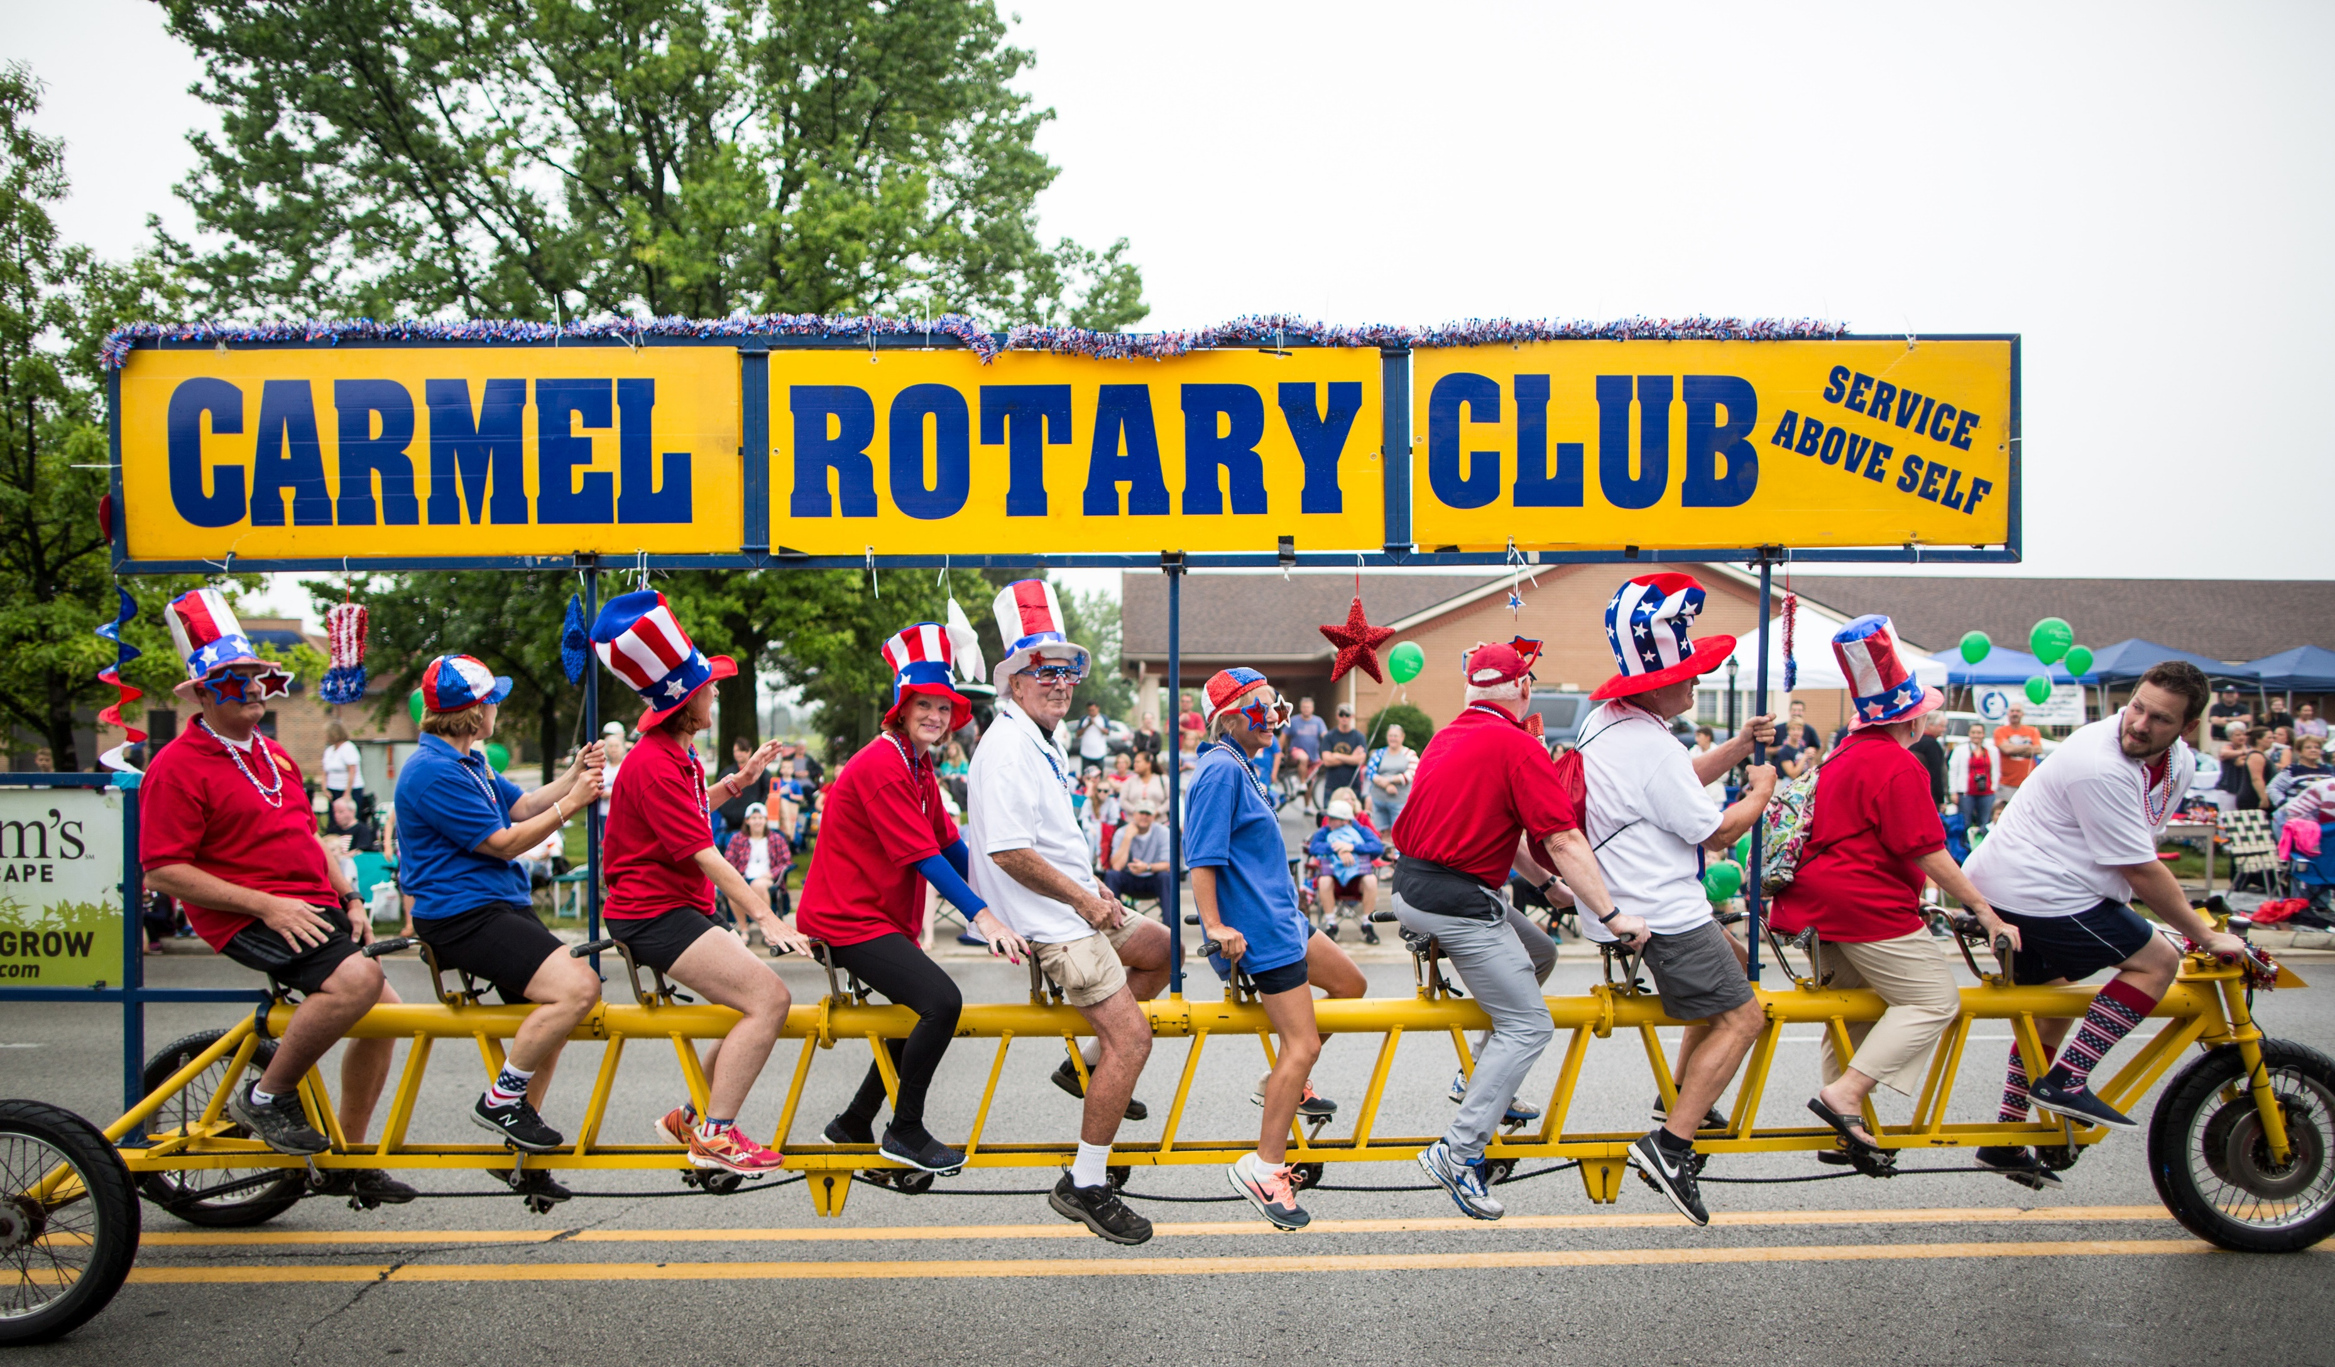

Slide 20


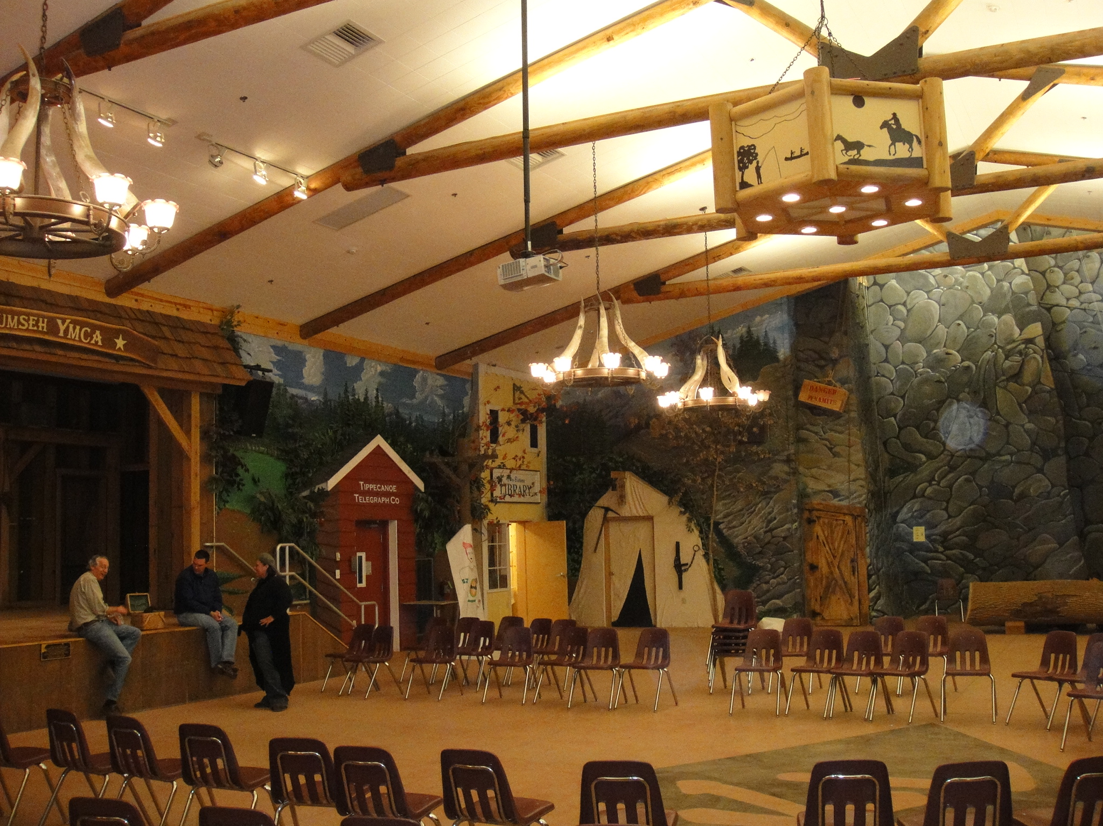
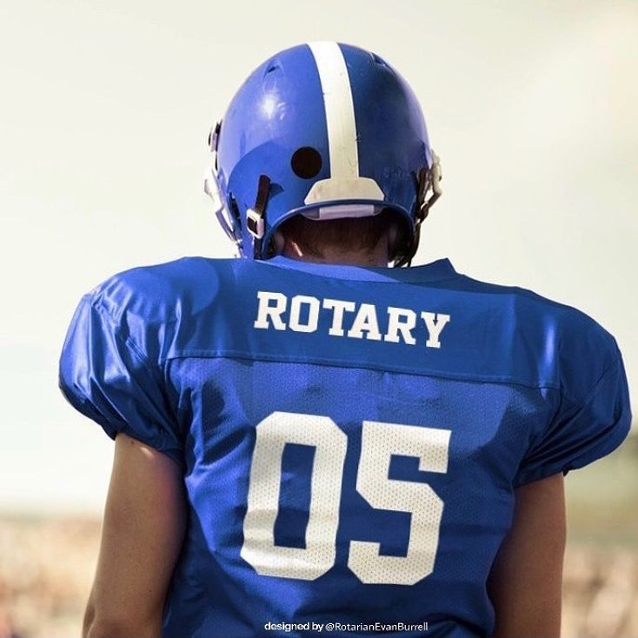
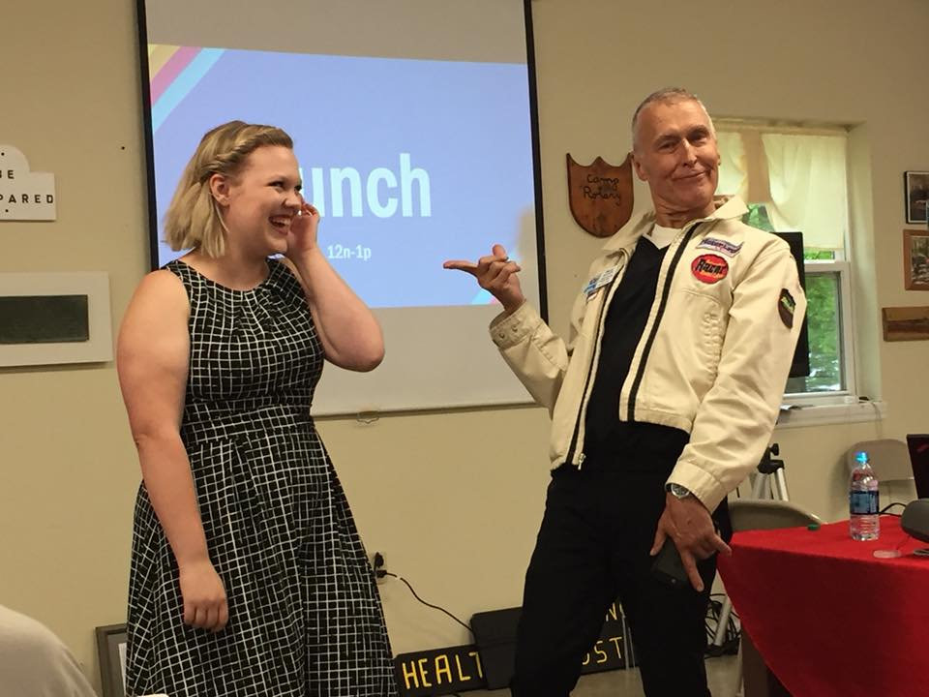
Interact, Rotaract, & Rotary Youth Leadership Award

Slide 21
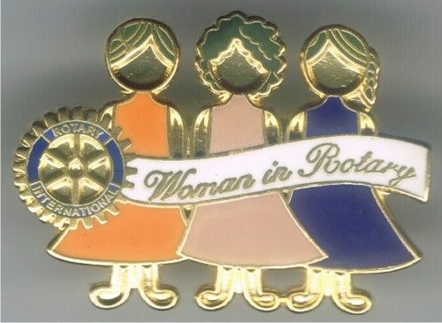
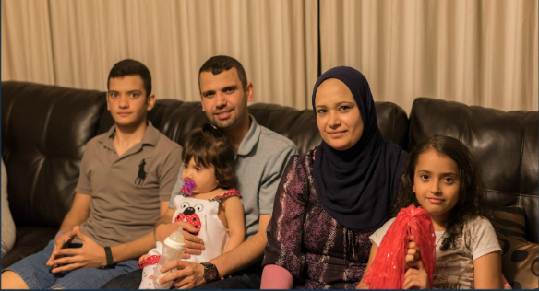

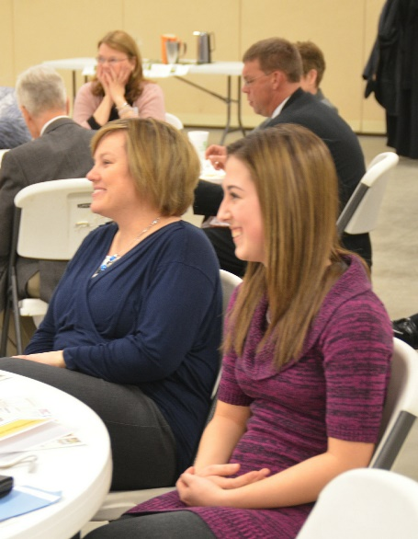
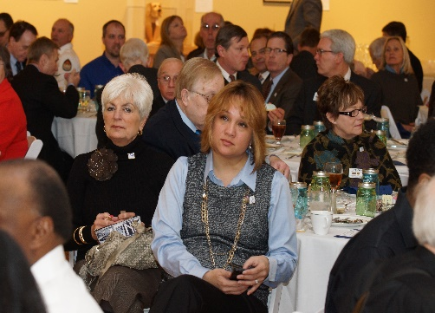
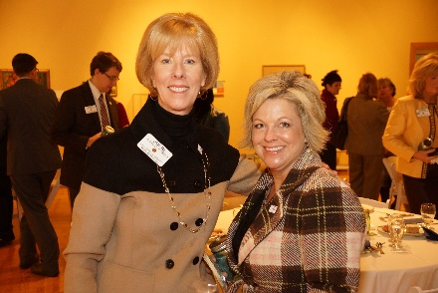
Women In Rotary

Slide 22
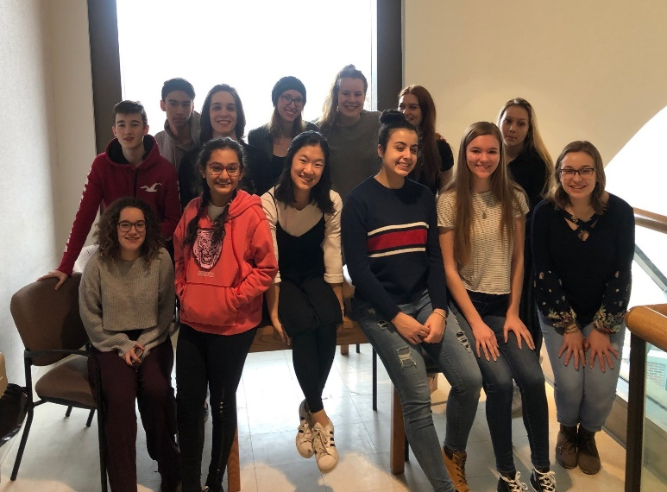
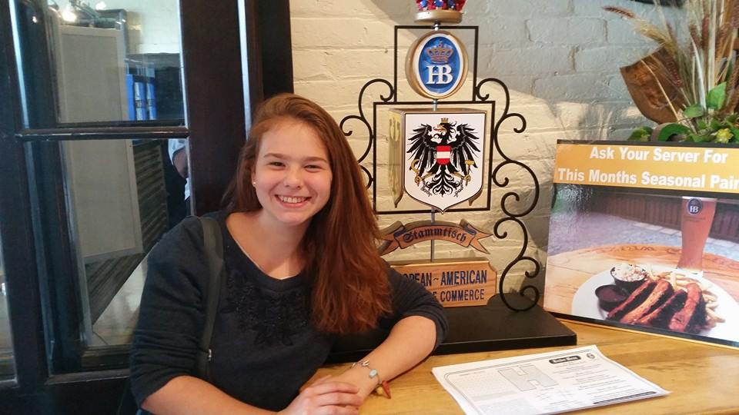
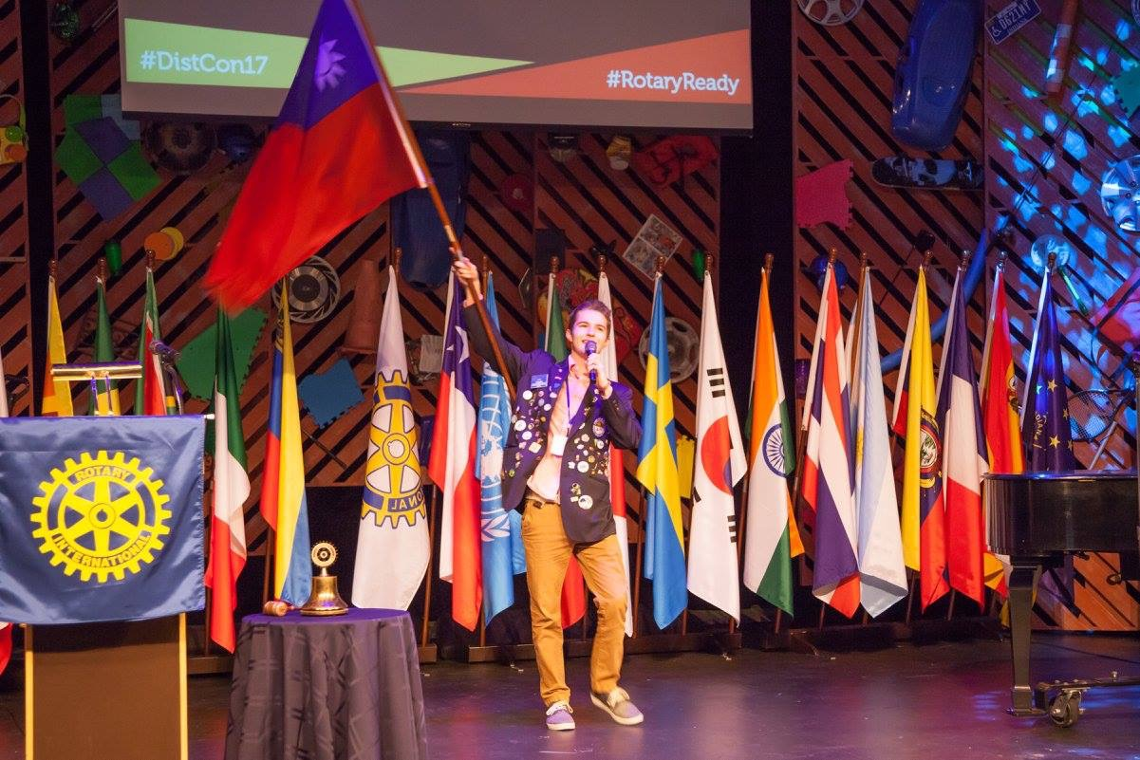
Rotary Youth Exchange

Slide 23
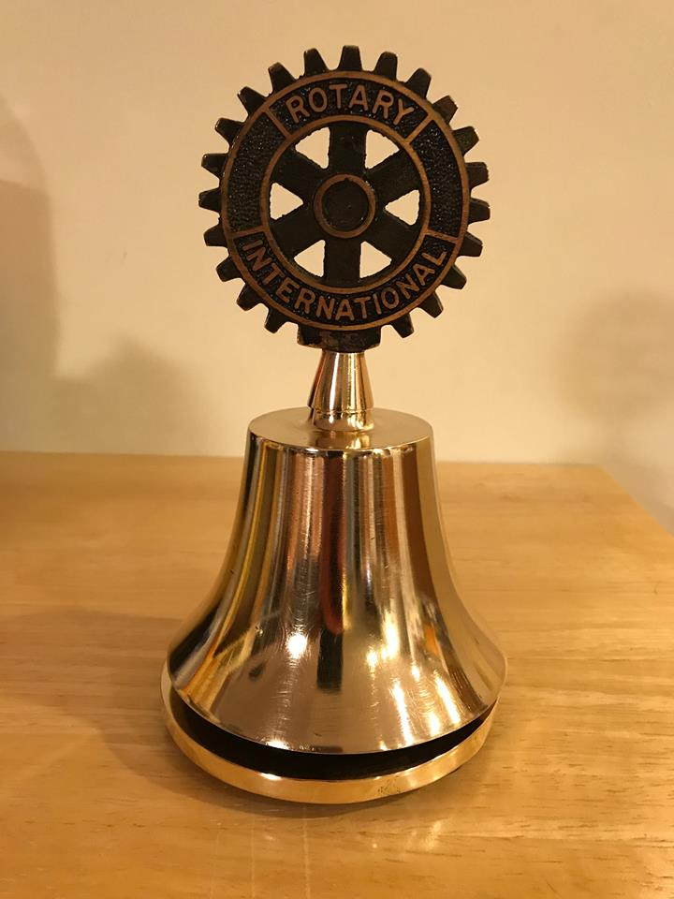
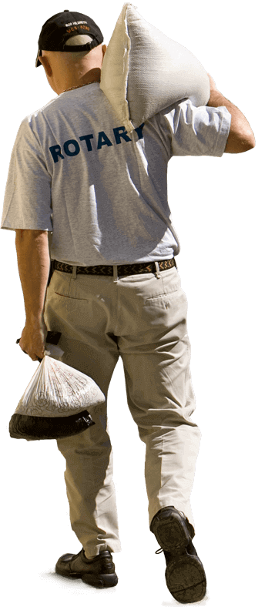

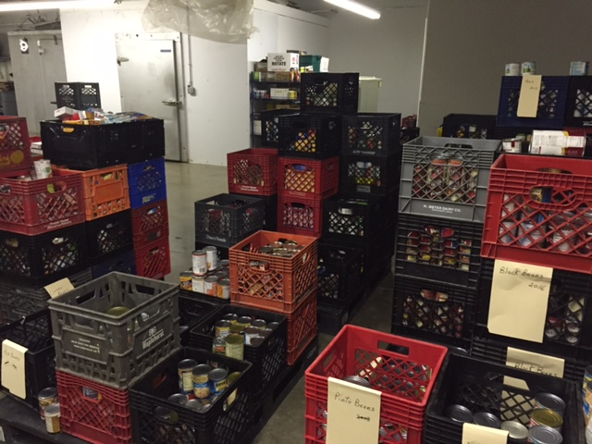
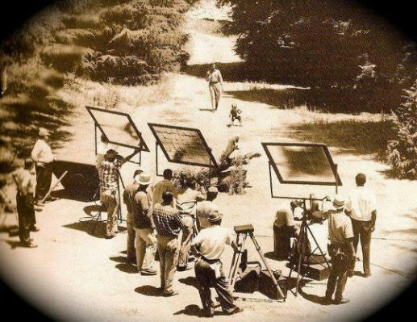
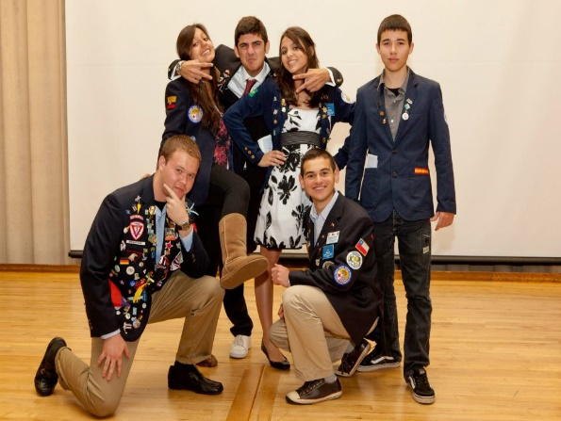
Rotary Club•Rotary Community•Rotary International

Slide 24


Slide 25
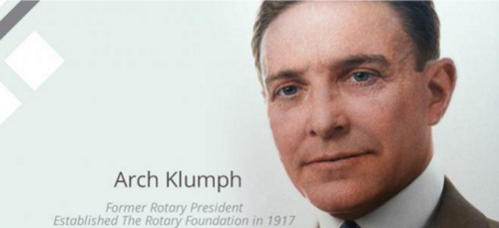

$26.50
in 1917

Slide 26
2.6 million babies are
stillborn each year

Slide 27
300,000 women die
each year giving birth

Slide 28
Another 2.9 million
die within a month

Slide 29
700,000 children die each year
from diarrhea,
2,000 every day

Slide 30
1,400,000 children die from other water-born illnesses,
4,000 every day

Slide 31
775 million adults in the world
are illiterate

Slide 32
Wars and terrorism ravage
people all over the world

Slide 33
21% of the world’s population
lives in extreme poverty,
almost
1.5 billion people

Slide 34
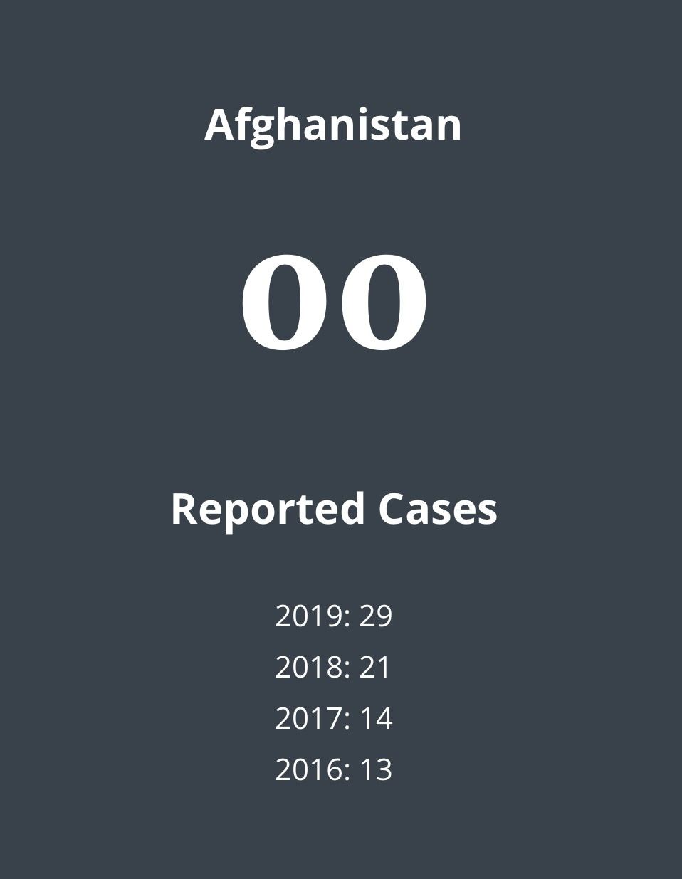

Slide 35
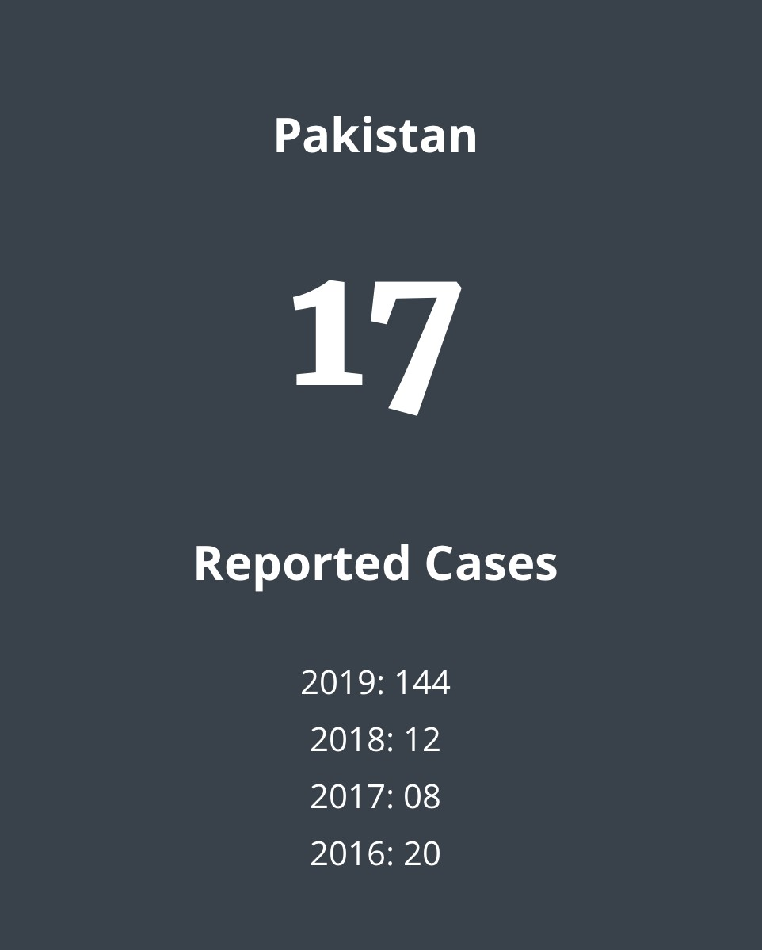

Slide 36


Slide 37


Slide 38
Thank
You

Slide 39


Slide 40


Slide 41


Slide 42


Slide 43


Slide 44
Rotary International District 6560
Dale Basham,
District Governor 2018-2019

